Slide 1

12/10/2024
ANALYSIS CHALLENGE
By Group III
Mustapha Mbengue, Huanlin Dai, Ursula Guo, Huanxi Wu

Slide 2

TABLE OF CONTENT
01
Statement Of Purpose
04
Model Performance
02
EDA
05
Summary
03
Model Selection

Slide 3

Analysis Scope
The analysis focuses on time series data from various economic indicators from January 1948 to the November 2024. The prediction strategy involves leveraging historical data to predict unemployment rates for future periods. Datasets will be combined, preprocessed, and modeled to identify trends and relationships between the outcome variable (unemployment rate) and predictors.

Slide 4
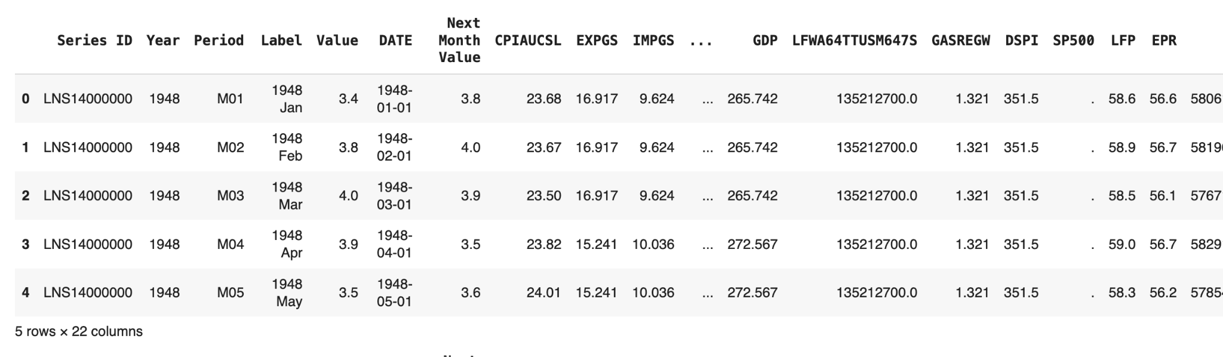
Analysis Objective
Predict the unemployment rate at t+1 (e.g., December 2024) using all available data up to time 𝑡 (e.g., November 2024).
Outcome Variable

Slide 5
20 FEATURE VARIABLES
+ 1 Time Variable
Macro Economics Metrics
Micro Economics Metrics
Labor Metrics
Consumer Price Index,
Effective Federal Funds Rate,
Gross Domestic Product,
Gross Domestic Income,
Imports of Goods and Services,
Exports of Goods and Services,
Disposable Personal Income,
Capital Expenditure,
Business Expenditures
S&P 500,
Consumer Index for Rent,
Gas Price, Health Expenditure Per Capita
Labor Population,
Working Age Population,
Average Weeks Unemployed,
Labor Force Participation Rate,
Unemployment Rate,
Unemployment Level,
Employment Level,
Civilian Labor Force Level

Slide 6
STATEMENT OF PURPOSE
The goal is to develop predictive models for the U.S. unemployment rate (U3) to understand labor market dynamics better and provide actionable insights for policymakers and economists. This involves providing the best prediction in terms of accuracy for the December U3 rate, and potentially identifying economic indicators influencing unemployment and forecasting unemployment rates over short-term horizons.

Slide 7

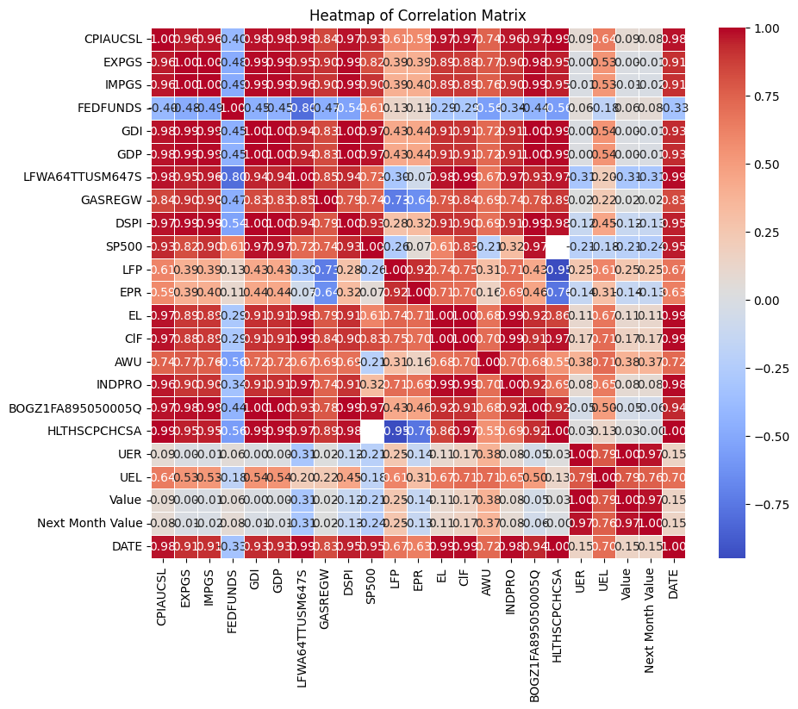
TRENDS IN FEATURES

Slide 8
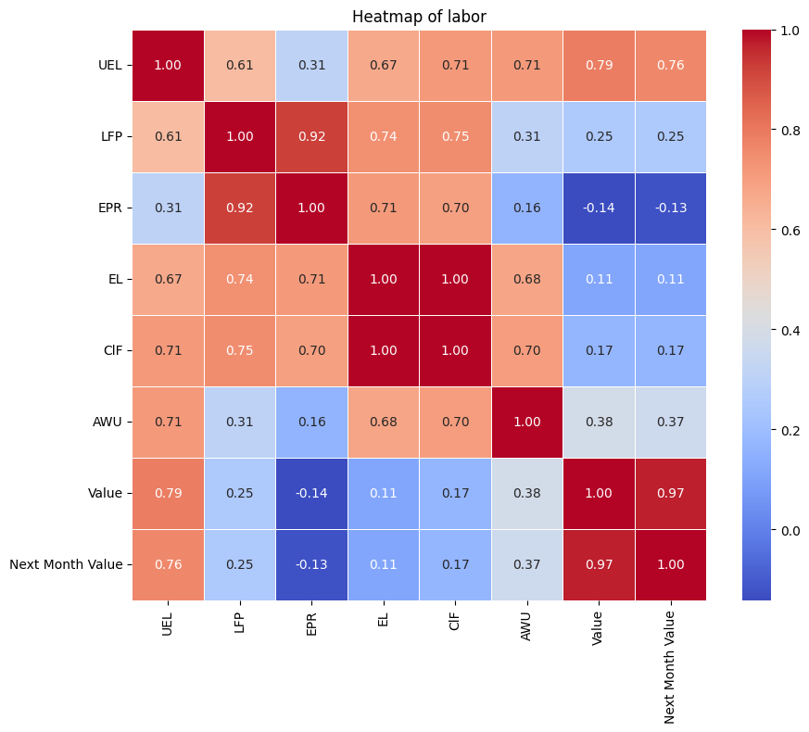
Correlation between Labor Metrics
Outcome Variable
U3 rate at time t is highly correlated with this month U3 rate at time t-1.
All the labor statistics we used here are not highly correlated with each other except for EL (Employment Level) and CIF (Civilian Labor Force Level)

Slide 9
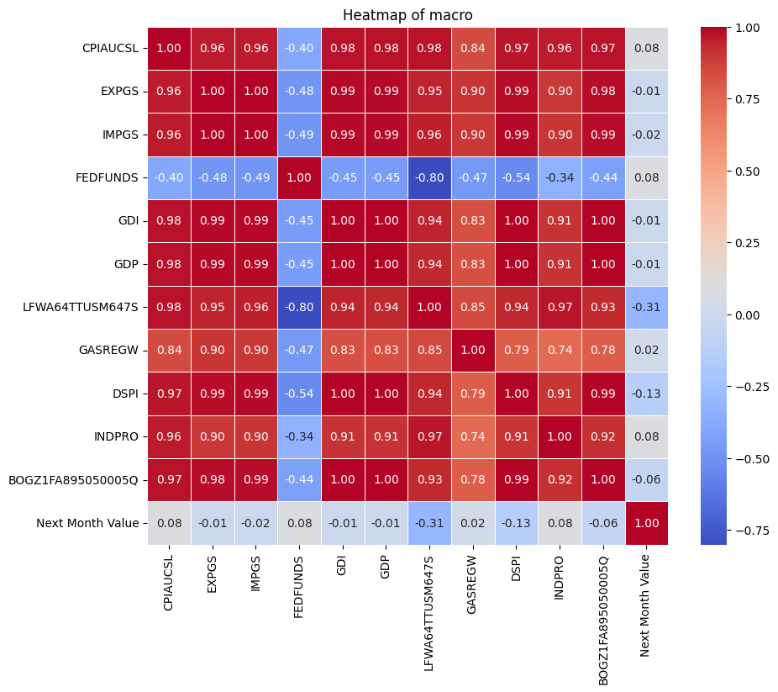
Correlation between Macro Metrics
Outcome Variable
Correlation with U3 rate and most macroeconomics metrics are low.
Most macroeconomics metrics are highly correlated with one another, with the exception of FFDFUNDS (Federal Funds Rate).

Slide 10
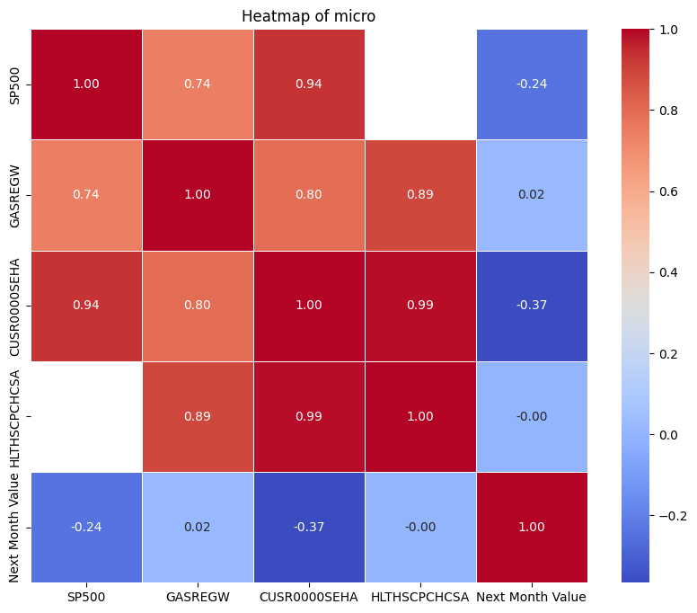
Correlation between Micro Metrics
Outcome Variable
Correlation with U3 rate and most microeconomics metrics is higher than the macro metrics.
Most microeconomics metrics are highly correlated with one another, with the exception of FFDFUNDS (Federal Funds Rate).

Slide 11
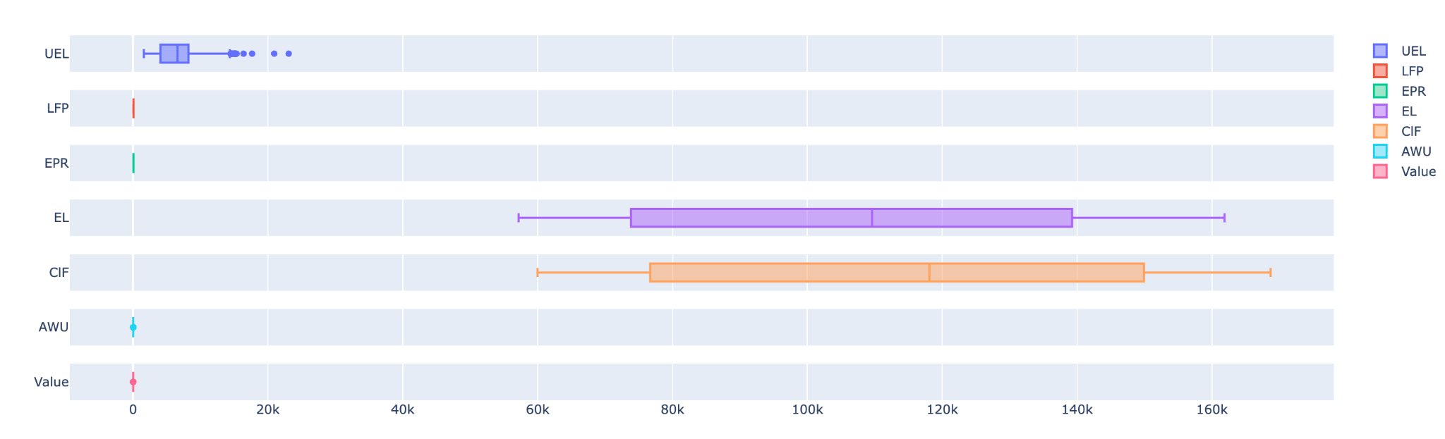
Labor Metrics Distribution

Slide 12
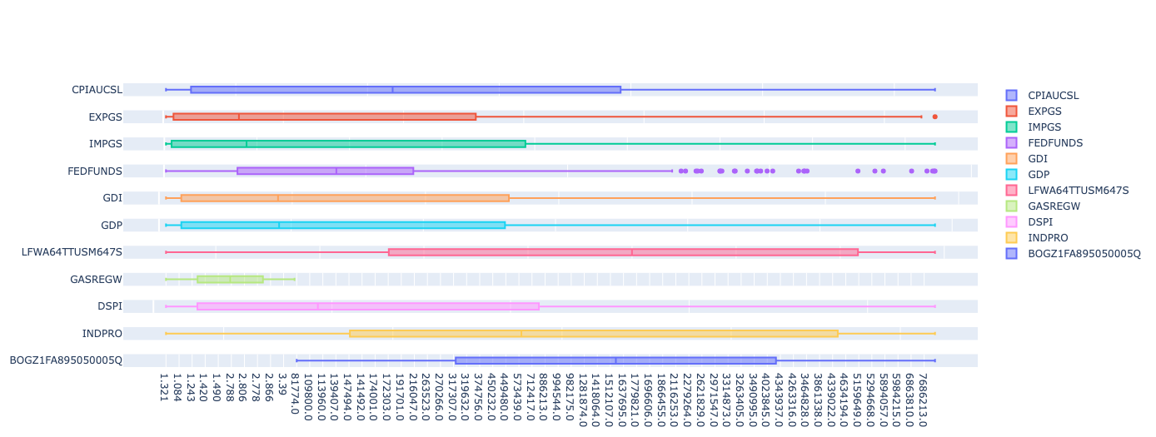
Macro Metrics Distribution

Slide 13
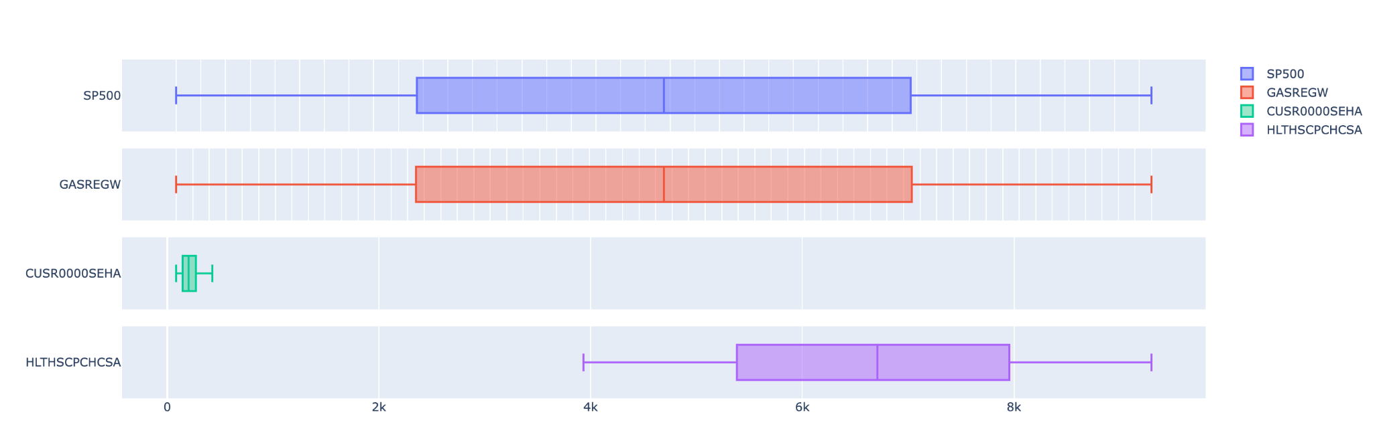
Micro Metrics Distribution

Slide 14
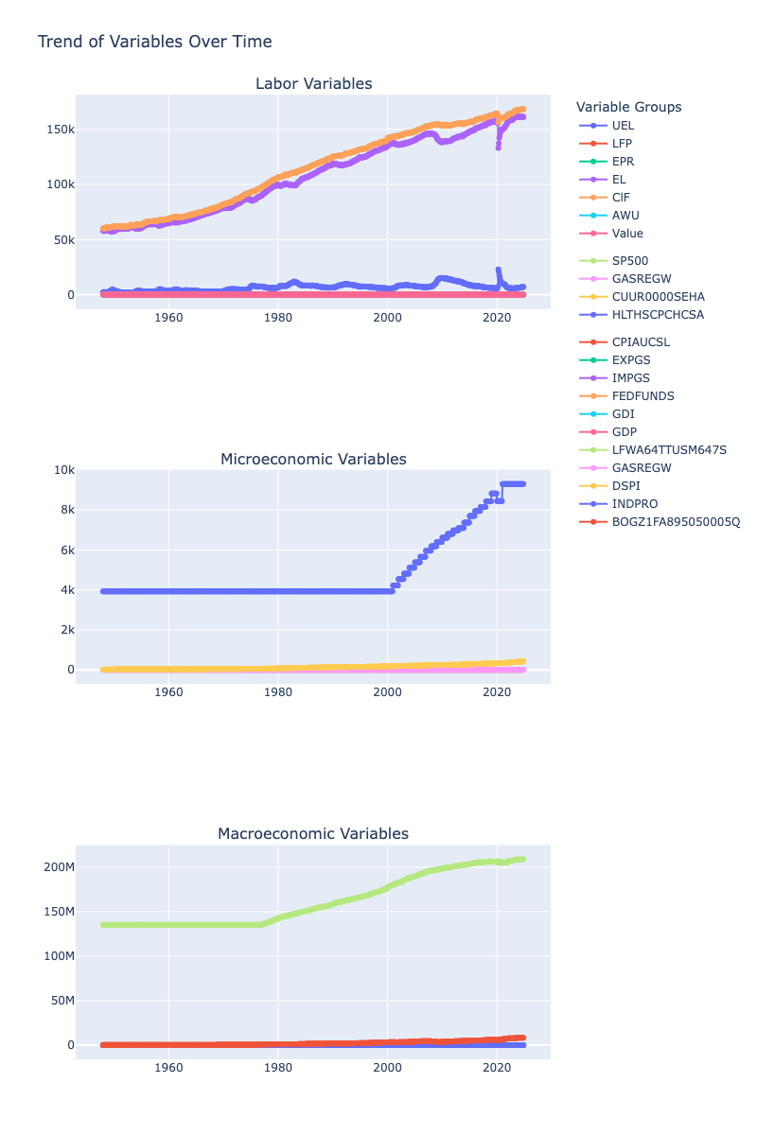
Time Trend
of Features

Slide 15

Feature Imputation
FIRST impute for different frequencies
If feature has daily updates:
Sum over days in a month, then average to get monthly value.
Else if feature has weekly updates:
Sum over weeks in a month, then average to get monthly value.
Else if feature has monthly updates:
Leave as is.
Else if feature has quarterly updates:
Fill the three months in each quarter with the same quarterly value.
Else if feature has yearly updates:
Fill the 12 months in each year with the same yearly value
THEN use forward filling for data that started after the earliest U3 record; and use and backward filling for data that ends before the latest U3 record.

Slide 16

MODEL SELECTION
Next slide

Slide 17
MODEL SELECTION
Linear Regression
ARIMA Model
Pros:
Simple to use
Easy to train
Looks at combinations of multiple variables that could be confounding
Cons:
Does not account for time-based variation or effects in data, like seasonality
Pros:
Can account for time-based effects
Has parameters for increasing complexity of model
Has forecasting built in
Cons:
Takes longer to train
Prone to overfitting if parameters are set too high
Only looks at a single variable, ignoring confounding variables altogether

Slide 18
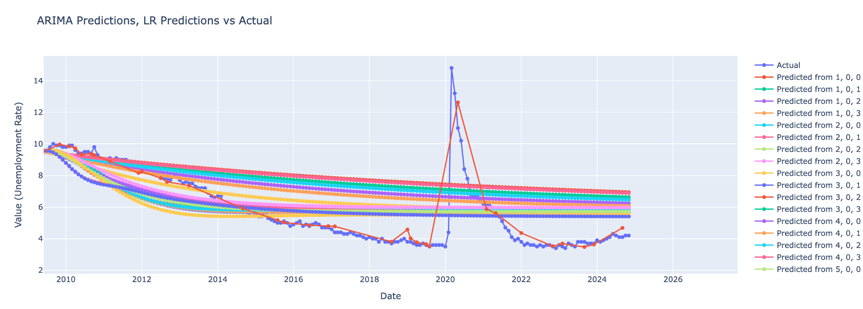
Model Performance
Linear Regression!

Slide 19
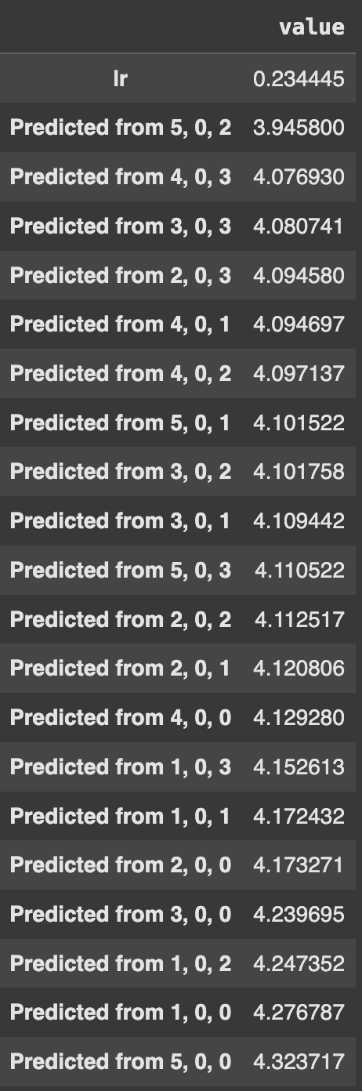
Model Performance
LR performed the best!
We suppose this is because Linear Regression can take advantage of the many different variables provided, while ARIMA can’t (it predicts future U3 values from only U3 values).

Slide 20
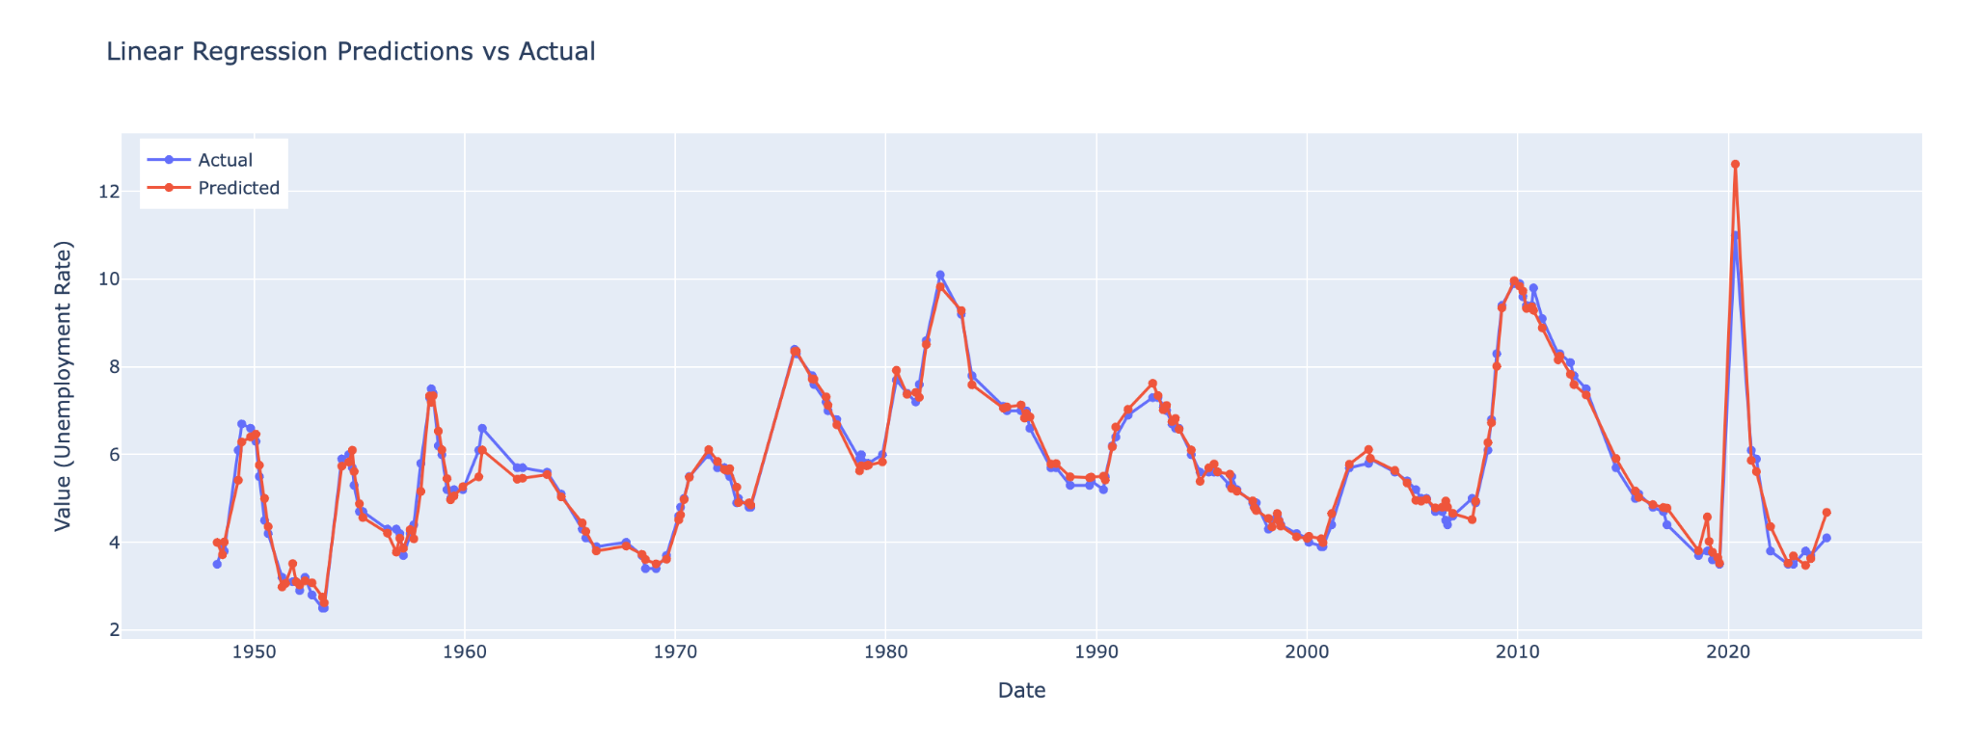
Backward Selection Model Performance - Out of Sample

Slide 21
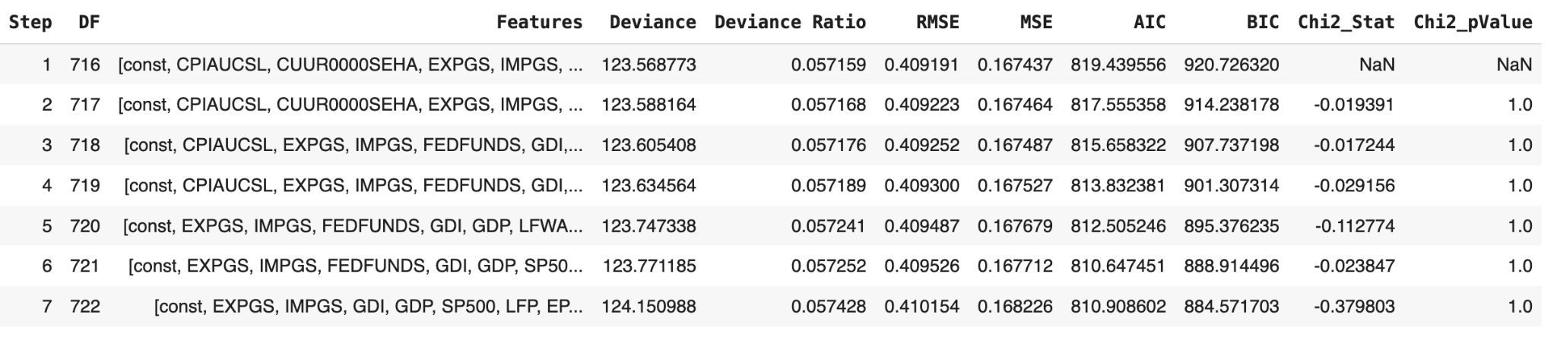
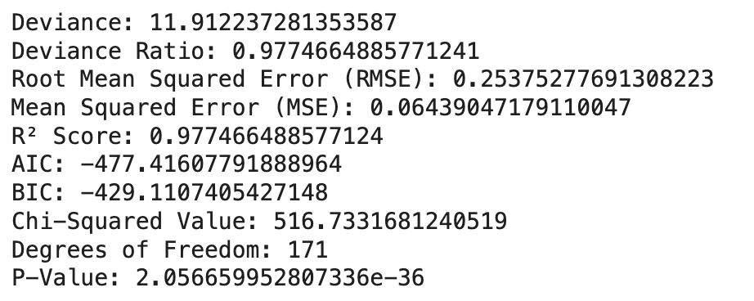
Further Improved Linear Regression using Backward Stepping
7 Steps
Statistics from Test Dataset using Final Model

Slide 22
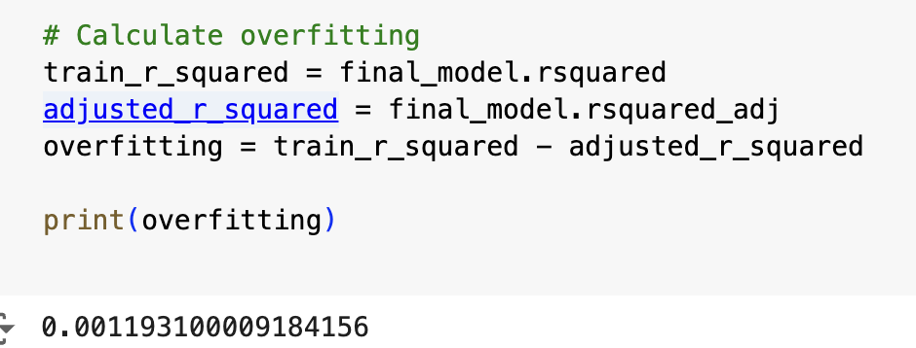
Further Improved Linear Regression using Backward Stepping
Overfitting Measure=R2−Adjusted R2
A small difference here 0.00119 suggests minimal overfitting.
Indicates that the predictors in the model are contributing meaningfully to explaining the variance in the dependent variable.

Slide 23
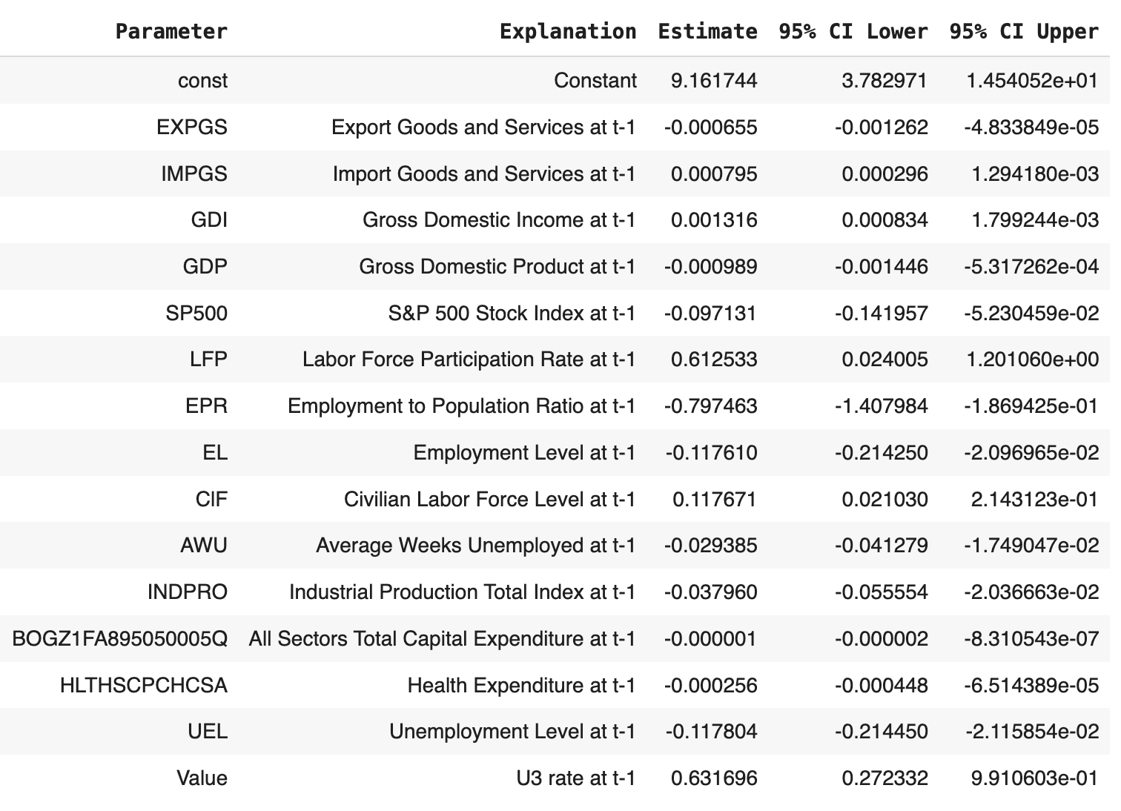
Further Improved Linear Regression using Backward Stepping
15 Features
Features that drives up unemployment rate:
Imports level at t-1;
GDI at t-1; Labor Force Participation Rate at t-1; Civilian Labor Level at t-1; Unemployment Rate at t-1

Slide 24
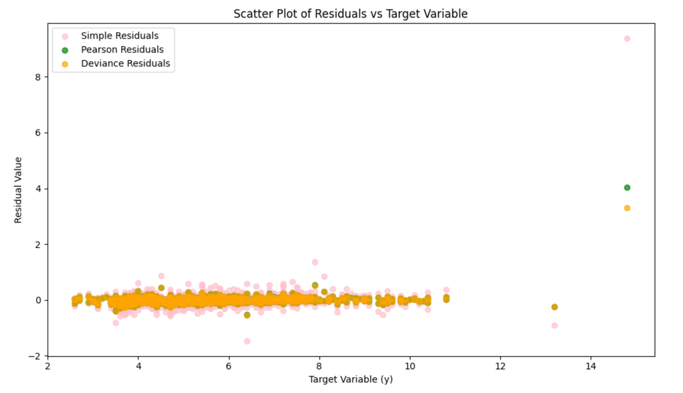
Residuals
But model tend to systematically underpredict on higher values of U3 rate.
Evenly spread out residuals implies model performs well over all values of y, and holds homoscedastic assumption

Slide 25
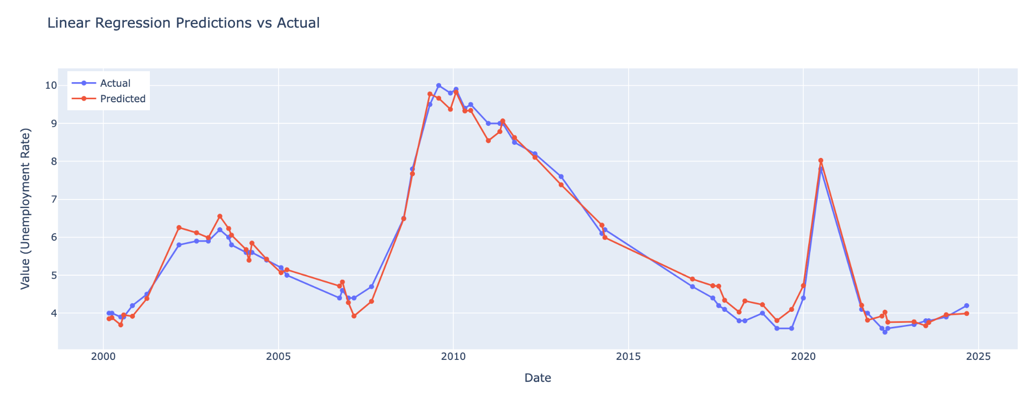
Using the same model features, but to train Linear Regression on data after 2000
Seem to have address the overprediction issue that we encountered before

Slide 26

Summary
Using all the historical data:
Predicted December U3 unemployment rate using November data is: 5.7452. 95% Confidence Interval of this number is between 5.6489 and 5.8415
Using only data after 2000:
Predicted December U3 unemployment rate is 4.46, much closer to the actual number with 95% Confidence Interval: [3.9219, 5.0117].
Limitations: We imputed some November data due to delay in government agencies in uploading the most recent data. But overall, we believe we have achieve the scope of analysis we’ve set at the beginning.
Thank you!

